Slide 1
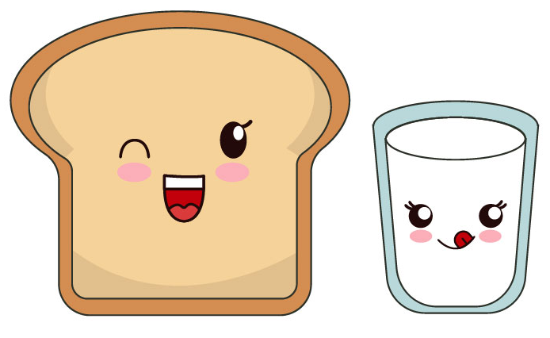
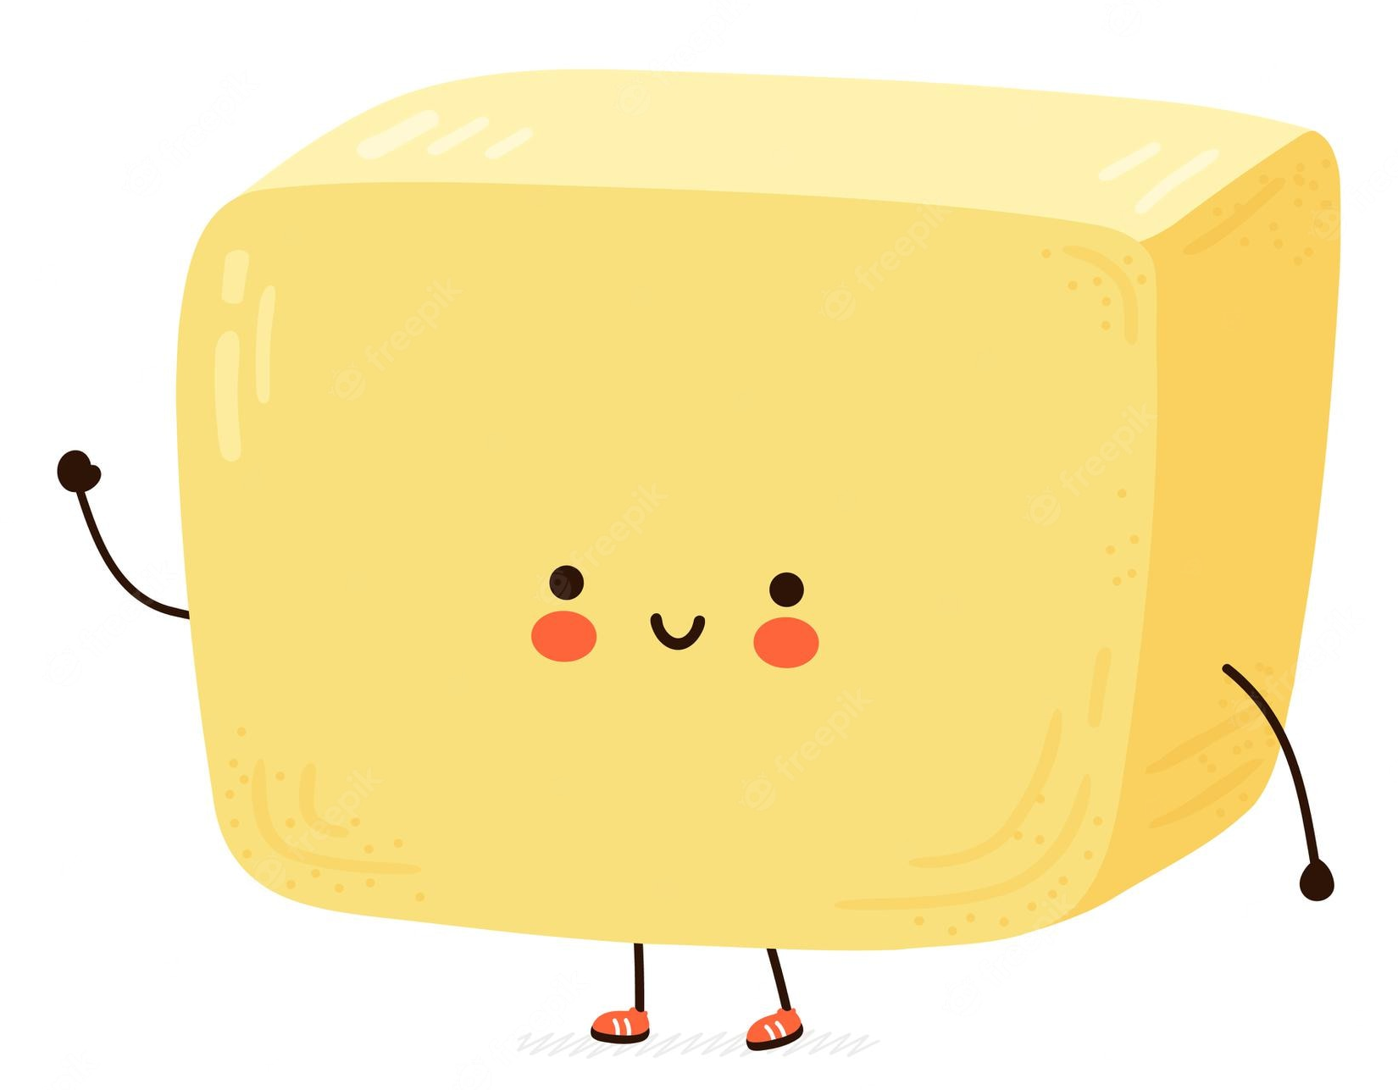

ASSOCIATION RULE MINING APRIORI AND FP GROWTH ALGORITHMS

Slide 2
CONTENTS
ASSOCIATION RULES
APRIORI ALGORITHM
APRIORI CODE IN PYTHON
FP GROWTH ALGORITHM
FP TREE CONSTRUCTION
FP GROWTH CODE
COMPARISON BETWEEN APRIORI AND FP GROWTH ALGORITHMS

Slide 3
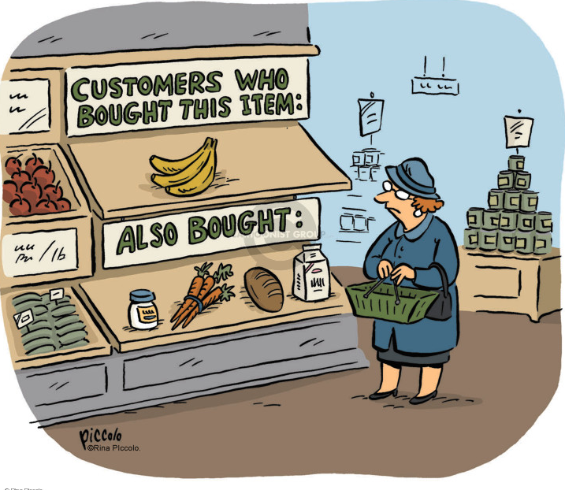
ASSOCIATION RULE MINING
In a given set of transactions, finding interesting associations and relationships among large sets of data items is Association Rule Mining.
Market Basket Analysis is one of the key techniques used by large relations to show association between items.
Allows retailers to identify relationships between the items that people buy together.
y together frequently.

Slide 4
On observing the given table, people who buy Cake also buy beer in most of the cases and people who buy milk may also buy coke If you look at a lot of such transactions, we can observe certain patterns in the form of rules. We call them association rules.
TID | ITEMS
1 | Bread , Milk
2 | Bread ,Cake,Beer , Eggs
3 | Milk ,Cake ,Beer , Coke
4 | Bread ,Milk ,Cake , Beer
5 | Bread ,Milk ,Cake , Coke

Slide 5
There are two parts in an association rule: the left hand side is an itemset ; that means, a collection of items such as milk , bread etc and so as the right hand side.
Examples of Association Rules:
{Cake} -> {Beer}
{Milk,Bread} -> {Eggs,Coke}
{Beer,Bread} -> {Milk}
Can we find some association between these two items? In other words, how can we assume that whenever customer buys bread and milk,he most probably buys beer???

Slide 6
So as to find out the association between the items we have to define three terms:
SUPPORT:
Fraction of transactions that contain the itemsets X and Y
CONFIDENCE:
Measures how often items in Y appear in transactions that contain X

Slide 7
LIFT: Confidence of the rule divided by expected confidence
Lift near 1 indicates X and Y almost appear together as expected
Lift >1 indicates X and Y appear together more than expected
Lift<1 indicates X and Y appear together less than expected.
NOTE:
For measuring associations for any transaction , we assume a minimum support and confidence . If it is not met, then the itemset is discarded.

Slide 8
From the table, consider the association rule {Milk,Cake}->{Beer}
TID | ITEMS
1 | Bread , Milk
2 | Bread , Cake ,Beer , Eggs
3 | Milk ,Cake ,Beer , Coke
4 | Bread ,Milk ,Cake , Beer
5 | Bread ,Milk ,Cake , Coke
Support= σ(Milk,Cake,Beer)/n = 2/5 =0.4
Confidence = σ(Milk,Cake,Beer)/σ(Milk,Cake)
= 2/3 = 0.67
Lift = supp(Milk,Cake,Beer)/supp(Milk,Cake)*supp(beer)
= 0.4/(0.6*0.6) = 1.11

Slide 9
APPLICATIONS:
This kind of pattern has huge commercial significance.
Discounting of one product may increase the sales of other.
Keeping the associated things together in a supermarket can increase sales.
This just don’t increase the profit to the market but the customer can also buy things which are essential
This type of association is not just present in market basket transactions but also in purchase of railway tickets, stocks etc.

Slide 10
APRIORI ALGORITHM
This algorithm is also called as FREQUENT PATTERN MINING.
DEFINITION OF APRIORI ALGORITHM
APRIORI - the basic algorithm for finding frequent itemsets.
The name of the algorithm is based on the fact that the algorithm uses prior knowledge of frequent itemset properties.
Apriori is designed to operate on database containing transactions.
Example: Collections of items bought by customers.
Apriori employs an iterative approach known as a level-wise search, where k item sets are used to explore (k + 1) item sets.

Slide 11
WHAT ACTUALLY APRIORI SAYS?
The probability that item I is not frequent is if :
P(I) < minimum support threshold, then I is not frequent.
P (I+A) < minimum support threshold, then I+A is not frequent, where A also belongs to itemset.
It follows Antimonotone property.
The steps followed in apriori algorithm of data mining are:
Join step
Prune step

Slide 12
KEY CONCEPTS
Frequent Itemsets : All the sets which contain the item with the minimum support
Apriori Property : Any subset of frequent itemset must be frequent.
Anti - monotonicity : It means if a set cannot pass a test, all of its supersets will fail the same test as well.
Join Step : This step generates (K+1) item set from K – itemsets by joining each item with itself
Prune Step : This step scans the count of each item in the database. If the candidate item does not meet minimum support , then it is regarded as infrequent and thus it is removed. This step is performed to reduce the size of the candidate itemsets.

Slide 13
STEPS TO PERFORM APRIORI ALGORITHM
ItemSets
generate k-itemset
candidate
(join steps)
Check each item with min_support (pruning step)
NO
YES
Set of K-1 frequent itemsets is NULL?
STOP
Frequent items (after pruning)

Slide 14



ITEMS BOUGHT | COUNT
Milk | 2
Eggs | 3
Tea | 3
Cold Drink | 3
Juice | 1
Cake | 1
TID | Items Bought
1 | Milk , Tea , Cake
2 | Eggs, Tea, Cold Drink
3 | Milk, Eggs, Tea, Cold Drink
4 | Eggs, Cold Drink
5 | Juice
ITEMS BOUGHT | COUNT
Milk , Eggs | 1
Milk , Tea | 2
Milk , Cold Drink | 1
Eggs , Tea | 2
Eggs, Cold Drink | 3
Tea , Cold Drink | 2
Items Bought
Milk , Eggs
Milk , Tea
Milk , Cold Drink
Eggs , Tea
Eggs, Cold Drink
Tea , Cold Drink
Items Bought | COUNT
Milk | 2
Eggs | 3
Tea | 3
Cold Drink | 3
ITEMS BOUGHT | COUNT
Milk , Tea | 2
Eggs , Tea | 2
Eggs, Cold Drink | 3
Tea , Cold Drink | 2
ITEMS BOUGHT | COUNT
Eggs , Tea , Cold Drink | 2
There is only one item set with minimum support 2. So only one item set is frequent.

Slide 15
KNOW MORE..!
PROS:
This is the most simple and easy-to-understand and implement.
Join and Prune steps are easy to implement on item sets in database.
CONS:
It scans the database multiple times for generating candidate sets.
It requires large memory space due to large number of candidate generation.

Slide 16
APPLICATIONS
Used in the health industry – It enables the industry to bundle drugs that cause the least ADRs depending on the patient's characteristics.
E-Commerce retail shops.
Student’s course selection in the E-Learning platform.
Used in Stock management

Slide 17
FP GROWTH ALGORITHM
The FP-Growth Algorithm is an alternative way to find frequent item sets without using candidate generations, thus improving performance.
Divide and Conquer Strategy
The core of this method is the usage of a special data structure named frequent-pattern tree (FP-tree), which retains the item set association information.
This algorithm works as follows:
First, it compresses the input database creating an FP-tree instance to represent frequent items.
After this first step, it divides the compressed database into a set of conditional databases, each associated with one frequent pattern.
Finally, each such database is mined separately.

Slide 18
FP TREE
Compact data structure that stores quantitative information about frequent patterns in a database.
Each transaction is read and then mapped onto a path in the FP-tree.
As different transactions can have several items in common, their paths may overlap.
In the FP tree, the root node represents null, while the lower nodes represent the item sets. The associations of the nodes with the lower nodes, that is, the item sets with the other item sets, are maintained while forming the tree.

Slide 19
STEPS TO BE FOLLOWED:
Scan the Database to find the occurrences of the itemsets
Construct the FP tree ( root node -> NULL )
Examine the first transaction. The itemset with the max count is taken at the top and so on. The branch of the tree is constructed with itemsets in descending order of count
Similarly ,the next transaction is examined. The itemsets are ordered in descending order of count. If any itemset of the transaction is already present in another branch , then this transaction branch would share a common prefix to the root.
Also, the count of the itemset is incremented as it occurs in the transactions. The common node and new node count are increased by 1 as they are created and linked according to transactions.

Slide 20
Mine the created FP tree. the lowest node is examined first, along with the links of the lowest nodes. The lowest node represents the frequency pattern length 1. From this, traverse the path in the FP Tree. This path or paths is called a conditional pattern base. A conditional pattern base is a sub-database consisting of prefix paths in the FP tree occurring with the lowest node (suffix).
Construct a Conditional FP Tree, formed by a count of itemsets in the path. The itemsets meeting the threshold support are considered in the Conditional FP Tree.
Frequent Patterns are generated from the Conditional FP Tree.

Slide 21
EXAMPLE: The given data is a hypothetical dataset of transactions with each letter representing an item
TRANSACTION ID | ITEMS
T1 | {E,K,M,N,O,Y}
T2 | {D,E,K,N,O,Y}
T3 | {A,E,K,M}
T4 | {C,K,M,U,Y}
T5 | {C,E,I,K,O,O}

Slide 22
The frequency of each individual item is computed.
Let the minimum support be 3.
A Frequent Pattern set is built which will contain all the elements whose frequency is greater than or equal to the minimum support. These elements are stored in descending order of their respective frequencies. After insertion of the relevant items, the set L looks like this:-
L= {K : 5,
E : 4,
M : 3,
O : 3,
Y : 3}
ITEM | FREQUENCY
A | 1
C | 2
D | 1
E | 4
I | 1
K | 5
M | 3
N | 2
O | 3
U | 1
Y | 3
E | 4
K | 5
M | 3
O | 3
Y | 3

Slide 23
For each transaction, the respective Ordered-Item set is built.
Now, all the Ordered-Item sets are inserted into a Tree Data Structure
Now ,let’s see how the FP tree is constructed using the above ordered set
TRANSACTION ID | ITEMS | ORDERED-ITEMSET
T1 | {E,K,M,N,O,Y} | {K,E,M,O,Y}
T2 | {D,E,K,N,O,Y} | {K,E,O,Y}
T3 | {A,E,K,M} | {K,E,M}
T4 | {C,K,M,U,Y} | {K,M,Y}
T5 | {C,E,I,K,O,O} | {K,E,O}

Slide 24
NULL
NULL
K:1
K:2
a) Inserting the set {K,E,M,O,Y} b) Inserting the set {K,E,O,Y}
E:1
E:2
M:1
M:1
O:1
O:1
O:1
Y:1
Y:1
Y:1

Slide 25
NULL
NULL
K:3
K:4
c) Inserting the set {K,E,M} d) Inserting the set {K,M,Y}
E:3
E:3
M:2
M:2
M:1
O:1
O:1
O:1
O:1
Y:1
Y:1
Y:1
Y:1
Y:1

Slide 26
NULL
e) Inserting the set
{K,E,O}
K:5
E:4
M:2
M:1
O:1
O:2
Y:1
Y:1
Y:1

Slide 27
Now, for each item, the Conditional Pattern Base is computed
Now, for each item, the Conditional Frequent Pattern Tree is built
ITEMS | CONDITIONAL PATTERN BASE
Y | {{K,E,M,O:1},{K,E,O:1},{K,M:1}}
O | {{K,E,M:1},{K,E:2}}
M | {{K,E:2},{K:1}}
E | {K:4}
K
ITEMS | CONDITIONAL PATTERN BASE | CONDITIONAL FREQUENT PATTERN TREE
Y | {{K,E,M,O:1},{K,E,O:1},{K,M:1}} | {K:3}
O | {{K,E,M:1},{K,E:2}} | {K,E:3}
M | {{K,E:2},{K:1}} | {K:3}
E | {K:4} | {K:4}
K

Slide 28
From the Conditional Frequent Pattern tree, the Frequent Pattern rules are generated by pairing the items of the Conditional Frequent Pattern Tree set to the corresponding to the item as given in the below table.
For each row, two types of association rules can be inferred for example for the first row which contains the element, the rules K -> Y and Y -> K can be inferred. To determine the valid rule, the confidence of both the rules is calculated and the one with confidence greater than or equal to the minimum confidence value is retained.
ITEMS | FREQUENT PATTERN GENERATED
Y | {<K,Y:3>}
O | {<K,O:3>,<E,O:3>,<E,K,O:3>}
M | {<K,M:3>}
E | {<E,K:4>}
K

Slide 29
Let us consider the minimum confidence as 0.65 Some of the association rules that can be formed are {K,O}->{E} (C=3/3=1) {E}->{O} (C=3/4=0.75) {M}->{K} (C=3/3=1) etc…
TRANSACTION ID | ITEMS
T1 | {E,K,M,N,O,Y}
T2 | {D,E,K,N,O,Y}
T3 | {A,E,K,M}
T4 | {C,K,M,U,Y}
T5 | {C,E,I,K,O,O}
ITEMS | FREQUENT PATTERN GENERATED
Y | {<K,Y:3>}
O | {<K,O:3>,<E,O:3>,<E,K,O:3>}
M | {<K,M:3>}
E | {<E,K:4>}
K

Slide 30
DIFFERENCE BETWEEN APRIORI AND FP GROWTH
APRIORI
FP GROWTH
array based algorithm.
uses Join and Prune technique.
uses a breadth-first search
utilizes a level-wise approach where it generates patterns containing 1 item, then 2 items, then 3 items, and so on.
Candidate generation is extremely slow. Runtime increases exponentially depending on the number of different items.
tree based algorithm.
constructs conditional frequent pattern tree and conditional pattern base from database which satisfy minimum support.
uses a depth-first search
utilizes a pattern-growth approach means that, it only considers patterns actually existing in the database.
Runtime increases linearly, depending on the number of transactions and items

Slide 31
APRIORI
FP GROWTH
requires large memory space due to large number of candidate generation.
scans the database multiple times for generating candidate sets.
requires less memory space due to compact structure and no candidate generation.
scans the database only twice for constructing frequent pattern tree.

Slide 32
THANK YOU
PRESENTED BY TEAM-9
TEAM MEMBERS:
T Jayanth
A Sandhya
B Veda Varshitha
G Kavya
V N S Pranav Akhilesh

